Slide 1
Computer Forensics 2
Searching and Bookmarking Data

Slide 2
Introduction
Understanding data
Conducting a basic search
Introduction to Grep
Bookmarking your findings
Creating reports
File signature analysis

Slide 3
EnCase Concepts
Four files of note used by EnCase 6
Evidence file – “.E01”
Case information file – “.case”
Configuration files – “.ini”
Backup file – “.cbak”
Also have a Logical file – “.L01”
Changes in EnCase 7
New evidence file format – “.Ex01”
New logical evidence file format – “.Lx01”

Slide 4
Hashing and verifying
Purpose of the Hash
MD5 and SH1
EnCase Evidence File
Cyclic Redundancy Check – 32 bits
CRC is on each data block
MD5 calculated only on data
Significance of Hash sets
Header Contains Case Information
Header
CRC
Data
Block
C
R
C
Data
Block
C
R
C
Data
Block
C
R
C
MD5

Slide 5
EnCase computes a CRC for every block of 64 Sectors of Data (32 K) - Default setting
CRC
CRC
CRC – Cyclical Redundancy Check
Order specific - 1234 different to 4321 – produce same checksum but not same CRC
Probability against 2 Sectors with same CRC and different data – approximately 1 in 4 billion

Slide 6
CRC
64 Sectors of Data (32 K)
Header
MD5
Case No
Examiner
Etc.
Industry standard MD5 (Message Digest ) hash
Can also use SHA-1 or have both
Only for data blocks NOT CRC values
Hash value written into the evidence file becomes part of documentation of evidence
GRANULARITY – May adjust error checking down to one sector

Slide 7
EnCase 7
Updated the evidence file format – .E0x1 and .L0x1
Data is still stored in the blocks with the CRC
Still uses MD5 and SHA-1 hashing algorithms
New format enables the evidence file to be
Encrypted – public and private keys
Compressed – bzip2 compression algorithm
Old cases can be updated to the new format
Changing from the old format to the new format does not change the MD5

Slide 8
Understanding data
Binary
0’s and 1’s
For every bit you add, you double the possible combinations
binary decimal binary decimal
2⁰ = 1 2⁵ = 32
2¹ = 2 2⁶ = 64
2² = 4 2⁷ = 128
2³ = 8 2⁸ = 256
2⁴ = 16 2⁹ = 512

Slide 9
Most significant bits | Least significant bits
2⁷ | 2⁶ | 2⁵ | 2⁴ | 2³ | 2² | 2¹ | 2⁰
128 | 64 | 32 | 16 | 8 | 4 | 2 | 1
0 0 1 0 1 0 0 0
1 0 0 1 0 1 1 1
1 1 1 1 1 1 1 1
Notes:
Answers
32 + 8 = 40
128 + 16 + 4 + 2 + 1 = 151
128 + 64 + 32 + 16 + 8 + 4 + 2 + 1 = 255

Slide 10
Hexadecimal – base 16
Converting from binary
0 to 15
8 4 2 1 8 4 2 1
0 0 1 0 1 0 0 0
1 0 0 1 0 1 1 1
1 1 1 1 1 1 1 1
How to represent 10 or 14?
10 = A, 11 = B, 12 = C, 13 = D, 14 = E, 15 = F

Slide 11
Converting to Hexadecimal
2⁷ 2⁶ 2⁵ 2⁴ 2³ 2² 2¹ 2⁰
128 6 32 16 8 4 2 1
0 0 1 0 1 0 0 0
1 0 0 1 0 1 1 1
1 1 1 1 1 1 1 1
2³ 2² 2¹ 2⁰
8 4 2 1
Notes:
Ans In decimal = 40 and in Hexadecimal = 28_{h}
In decimal = 151 and in Hexadecimal = 97_{h}
In decimal = 255 and in Hexadecimal = FF_{h}

Slide 12
ASCII
Characters are displayed in standard format
Used by everyone
8 bit code
7 bits for data and 1 bit for parity
7 bits gives ? different combinations
Characters, punctuation, special codes
Called low or low-bit ASCII
IBM included the 8th bit – gives an extra 128 codes (graphics, mathematical symbols, etc)
Called high-bit ASCII
0 - 127

Slide 13
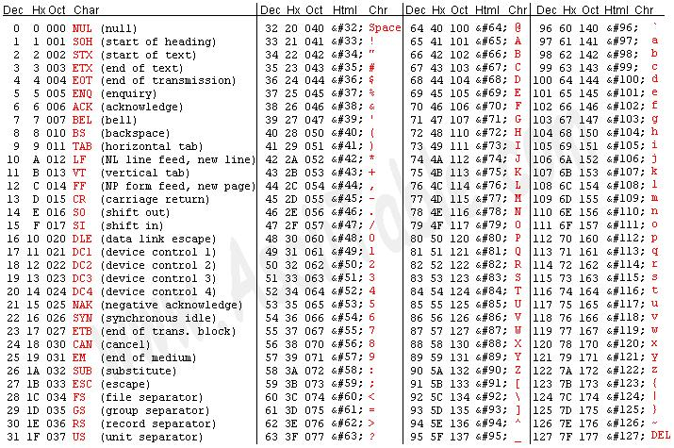

Slide 14
Unicode
Extended the number of characters
Worldwide standard for processing, displaying and interchanging all types of language texts
Extends to Chinese, Japanese and Korean chars
Uses 2 bytes per character
Example – letter A ASCII = 41h
Unicode = 4100h
Often stored using both Unicode and ASCII
You should search for your data in both formats

Slide 15
Big-endian
big-endian and little-endian refer to which bytes are most significant in multi-byte data types
describe the order in which a sequence of bytes is stored in a computer’s memory
big-endian - most significant value in the sequence is stored at the lowest storage address (i.e., first)
little-endian system, the least significant value in the sequence is stored first
Example - number 1025 (2 to the tenth power plus one) stored in a 4-byte integer:
00000000 00000000 00000100 00000001
Address Big-Endian Little-Endian
1025 1025
00 00000000 00000001 01 00000000 00000100 02 00000100 00000000 03 00000001 00000000 Many mainframe computers, particularly IBM mainframes, use a big-endian architecture.
Most modern computers, including PCs, use the little-endian system.

Slide 16
Consider a sequence of 4 bytes
Now problems start - when you read multi-byte data, where does the biggest byte appear?
Big endian: first byte is the biggest (most significant)
Little endian: first byte is smallest (least significant)
Byte Name: W X Y Z
Location: 0 1 2 3
Value (hex) stored: 12_{h} 34_{h} 56_{h} 78_{h}
Notes:
Ref: http://betterexplained.com/articles/understanding-big-and-little-endian-byte-order/

Slide 17
Byte Name: W X Y Z
Location: 0 1 2 3
Value (hex): 12_{h} 34_{h} 56_{h} 78_{h}
Example
An integer stored as 4 bytes
Big endian:
the first byte is the most significant
Read 4 bytes (W X Y Z) and W is the largest
The number is 12345678_{h}
Little endian
the first byte is smallest
Also read W X Y Z, but now W is the smallest.
The number is 78563412_{h}

Slide 18
Base 64
the cat sat on the mat
dGhlIGNhdCBzYXQgb24gdGhlIG1hdA==
binary data is encoded by treating it as numbers and translating it into a base 64 representation
commonly used when binary data is stored and transferred over media that are designed to deal with textual data
Can also encode images
Notes:
Ref: https://www.base64encode.org/
Examples - https://en.wikipedia.org/wiki/Base64

Slide 19
ROT13
the cat sat on the mat
gur png fng ba gur zng
rotate by 13 places
simple letter substitution cipher
Input | ABCDEFGHIJKLMNOPQRSTUVWXYZabcdefghijklmnopqrstuvwxyz
Output | NOPQRSTUVWXYZABCDEFGHIJKLMnopqrstuvwxyzabcdefghijklm
Notes:
Translator - http://www.rot13.com/

Slide 20
Searching for Data
Managing Keywords
Search strings are called keywords
Save keyword at the correct level
Keywords can be used from both the Case level and the Global level at the same time
Wastes resources looking for keywords that you don’t need

Slide 21
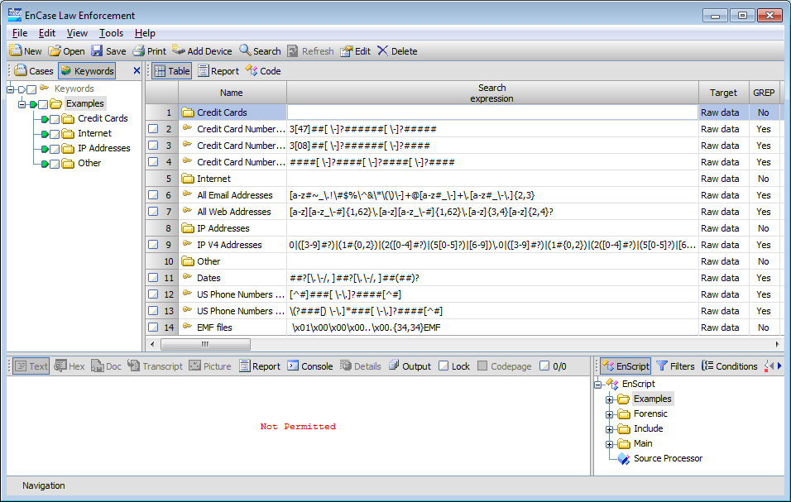
Global

Slide 22
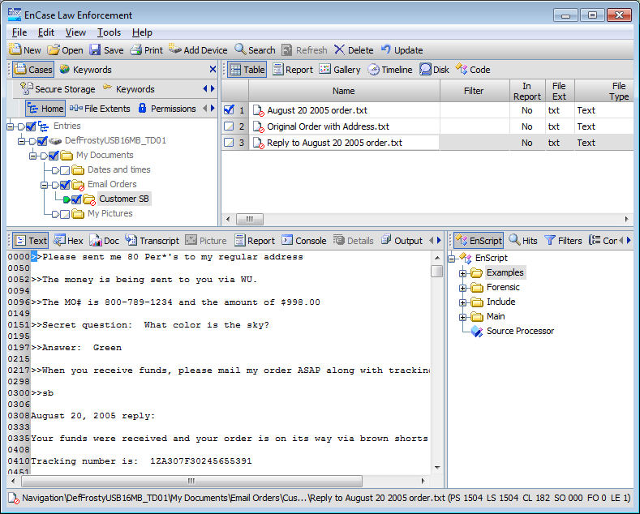
Global keywords
Case level keywords

Slide 23
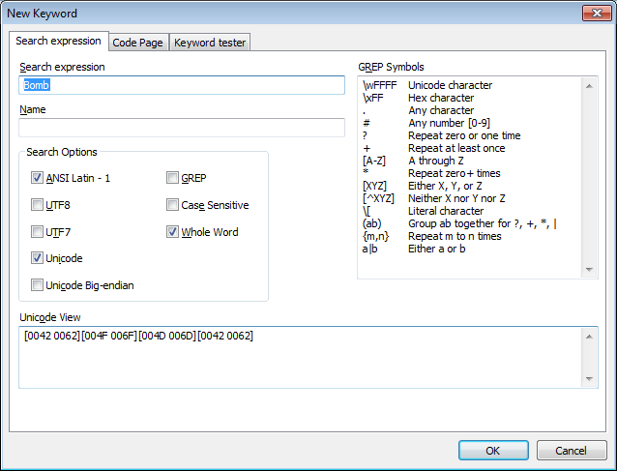
Upper and lower case “b”

Slide 24
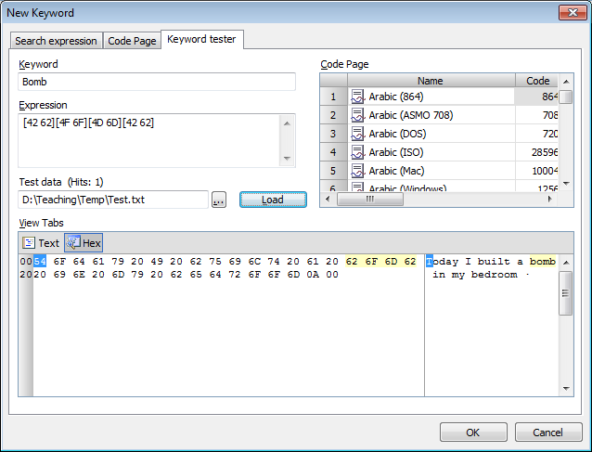
Testing your search expression

Slide 25
Keyword search options
Can be case sensitive
Import and export keywords
GREP
GREP is a powerful search tool
Standard GREP symbols and characters
Creates custom searches

Slide 26
“.” period matches any character – (John).(Smith)
finds “john” followed by any character followed by “smith”
john smith
john,smith
johnQsmith
Will not find JohnSmith
may want both the English and the American spellings of the word “grey/gray”, use gr[ea]y
any word starting with “moth” moth[a-z]*

Slide 27
. wildcard - any character (except line breaks) matches
# any digit - will match 0, 1, 2, 3, 4, 5, 6, 7, 8, or 9
\d
+ must be present at least once (1 or more times)
? may be present zero or one times
* present zero, one or multiple times repeated
[ABC] any char matches one char -
e.g. re[ea]d finds read, reed but not red
[^ABC] must NOT match any char - e.g. re[^a]d finds reed but not read
[a-c] defines a range
{X, Y} repeat X to Y times –
e.g. {2, 4} repeat 2 to 4 times
a|b OR a or b

Slide 28
Examples
Fred +rowson repeat space at least once
^
Joan -*twist may or may not be present once or multiple times
Jane? finds Jan or Jane (“e” may or may not be present)
http://www\.[a-z]+\.org
+ means repeat any number times - \. literal char
[456]### -? #### -?
Find one of these values
May or may not be present
digits

Slide 29
Al al… too general
Alan, Alen or Allen all?[ae]?n
Ecstacy or ecstasy ecsta c|s y
Search for a date range
From Jan, Feb or Mar - 1st 2nd or 3rd – 1999 or 2000
(Jan) | (Feb) | (Mar) [123] [(st) (nd) (rd)], (2000)|(1999)
Note – the operator only act on the preceding character
Jan|Feb will only find Jan or Jaf

Slide 30
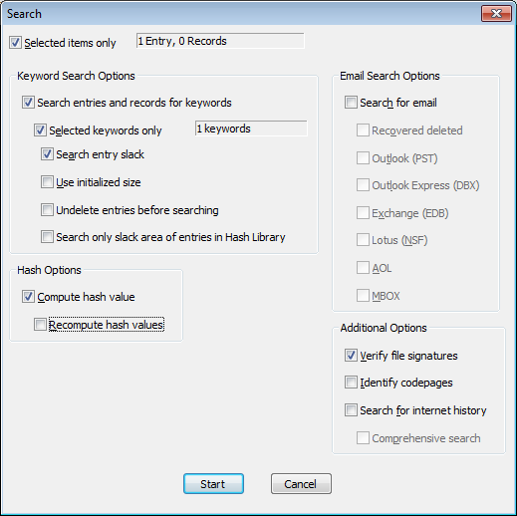

Slide 31
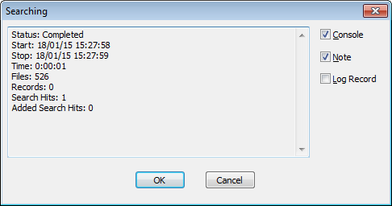
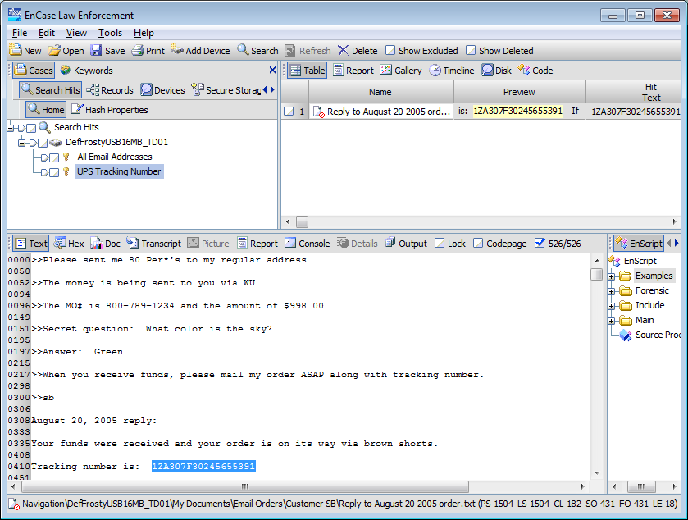

Slide 32
Bookmarking
References to specific files or data
Can be created anywhere that data is located
Are the foundation of your report
Critical skill
Most common – highlighted data bookmark
Located the data of interest in the View pane
Select the text using the mouse
Right click to bookmark

Slide 33
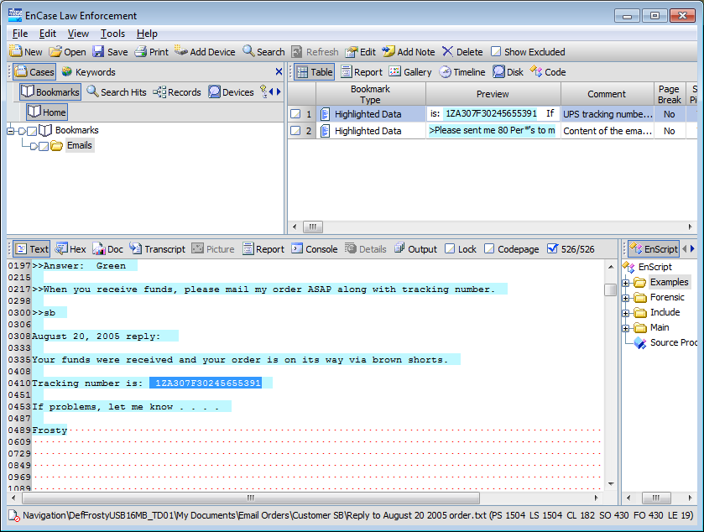

Slide 34
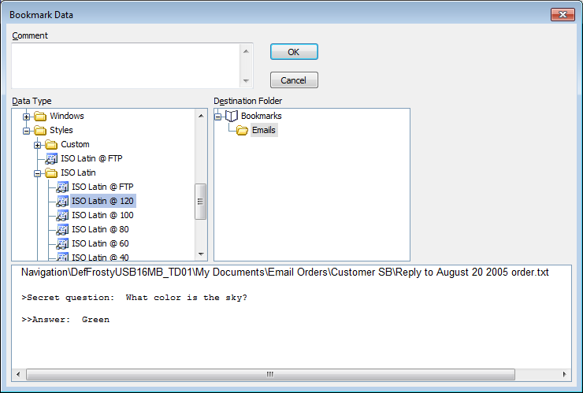

Slide 35
Different types of bookmarks
Highlighted data
Done by the examiner
Notable File Bookmark
Is significant for your case
Bookmarks the attributes\properties of the file
Not the contents (data)
File Group Bookmark
Like a notable file except it is created by blue checking a number of files
Bookmark selected items

Slide 36
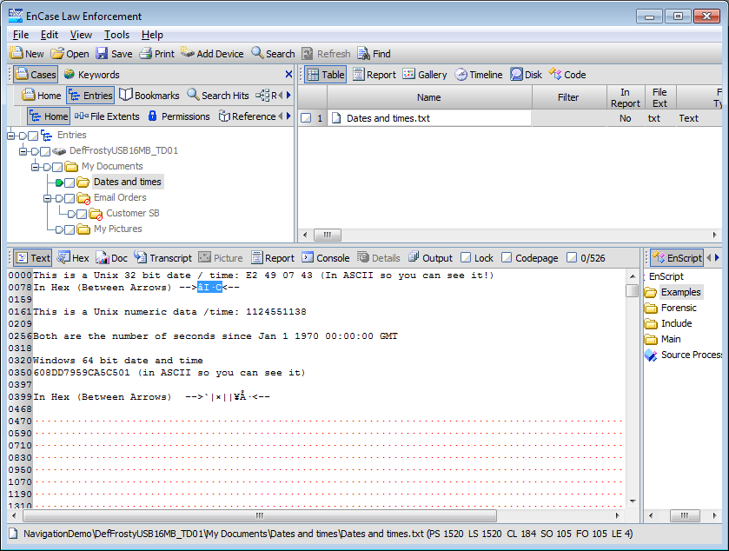
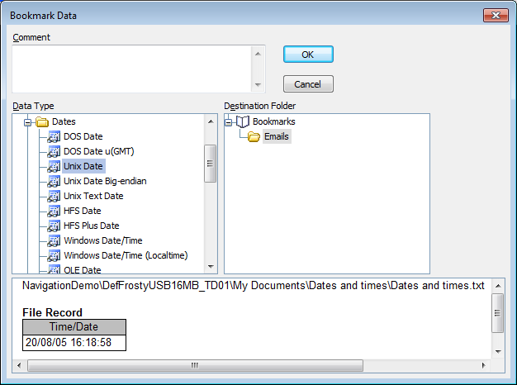

Slide 37
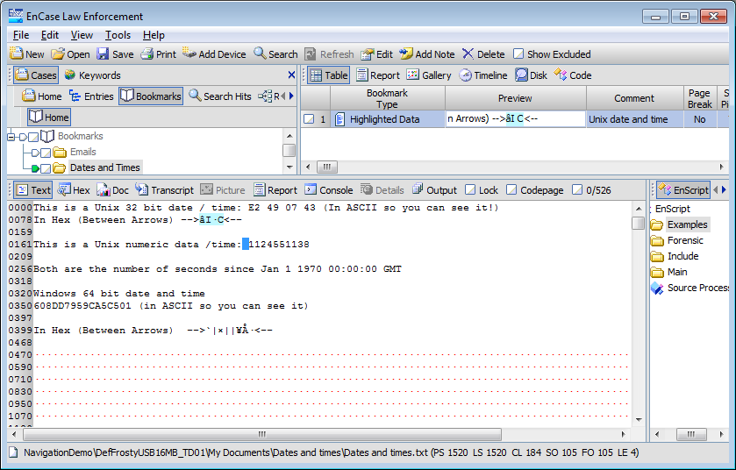

Slide 38
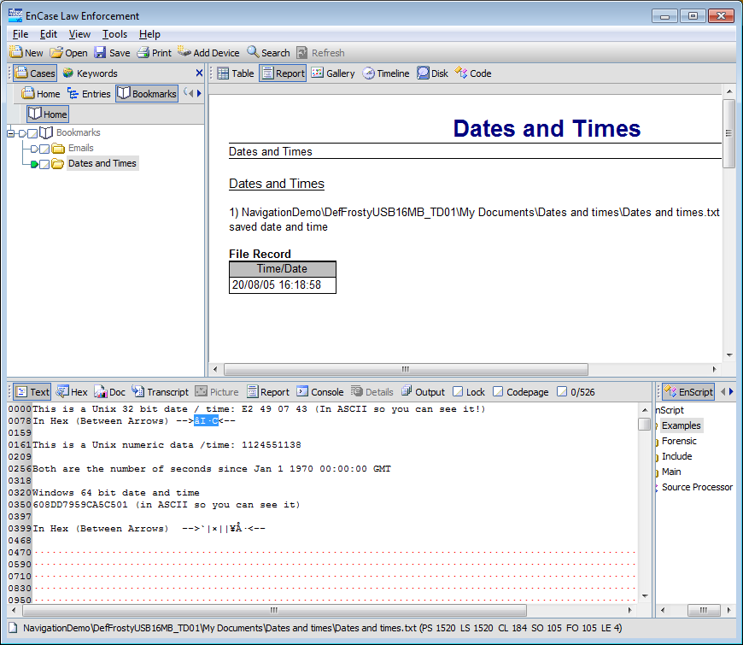
Generating Reports

Slide 39
Conducting a File Signature Analysis
Most files have a unique header
Also have filename extensions – e.g. .doc or .pdf
Windows uses file extensions to associate a file with an application
EnCase identifies the mismatch between file header and signature
Compares file header and the file’s signature
Perform file signature analysis

Slide 40
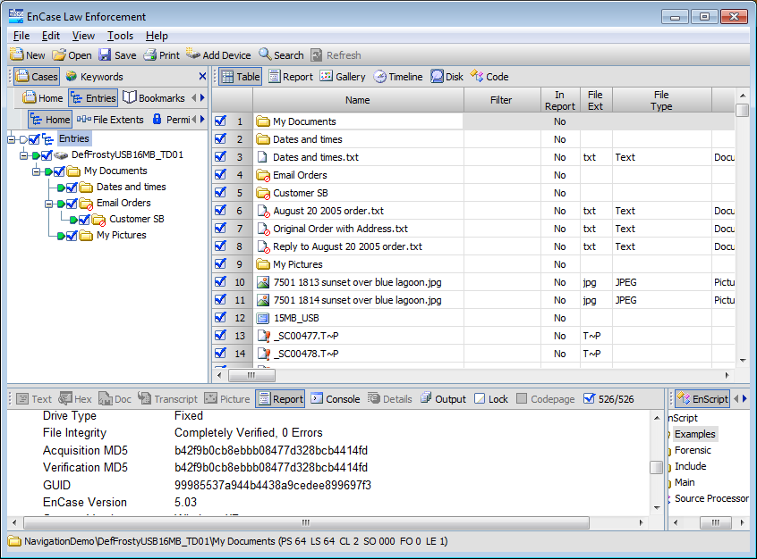

Slide 41

Run a file signature analysis after verifying your evidence file

Slide 42
Verifying File Signatures
Searching for mangled files
Forensics tools match the file signature and the file extension
Example – a jpg image
File name | File Signature | Signature | File Extension
Picture.jpg | FF D8 FF E0 | known | matches
Picture.dll | FF D8 FF E0 | known | incorrect
Anyfile.zza | FF D6 FE FF | unknown
Picture.xyz | D8 D8 FF E0 | unknown | bad signature

Slide 43
File Signature Analysis - Quiz
Extension
Signature
Alias
exe
MZ
Executable
bmp
BM
Bitmap Image
reg
REGEDIT
Registry File
ani
RIFF
Movie
txt
Text File
Calculate result of file signature analysis
Filename
RunMe.exe
Result of Analysis
File Signature
MZ
Match

Slide 44
File Signature Analysis - Quiz
Extension
Signature
Alias
exe
MZ
Executable
bmp
BM
Bitmap Image
reg
REGEDIT
Registry File
ani
RIFF
Movie
txt
Text File
Calculate result of file signature analysis
Filename
Hello.exe
Result of Analysis
File Signature
BM
*Bitmap Image

Slide 45
File Signature Analysis - Quiz
Extension
Signature
Alias
exe
MZ
Executable
bmp
BM
Bitmap Image
reg
REGEDIT
Registry File
ani
RIFF
Movie
txt
Text File
Calculate result of file signature analysis
Filename
Hello.bmp
Result of Analysis
File Signature
Riff..
*Movie

Slide 46
File Signature Analysis - Quiz
Extension
Signature
Alias
exe
MZ
Executable
bmp
BM
Bitmap Image
reg
REGEDIT
Registry File
ani
RIFF
Movie
txt
Text File
Calculate result of file signature analysis
Filename
Bad.ini
Result of Analysis
File Signature
8Bim
Unknown

Slide 47
File Signature Analysis - Quiz
Extension
Signature
Alias
exe
MZ
Executable
bmp
BM
Bitmap Image
reg
REGEDIT
Registry File
ani
RIFF
Movie
txt
Text File
Calculate result of file signature analysis
Filename
MyInfo.txt
Result of Analysis
File Signature
This file is ..
Match

Slide 48
File Signature Analysis - Quiz
Extension
Signature
Alias
exe
MZ
Executable
bmp
BM
Bitmap Image
reg
REGEDIT
Registry File
ani
RIFF
Movie
txt
Text File
Calculate result of file signature analysis
Filename
Install.dll
Result of Analysis
File Signature
[Install]..
!Bad Signature

Slide 49
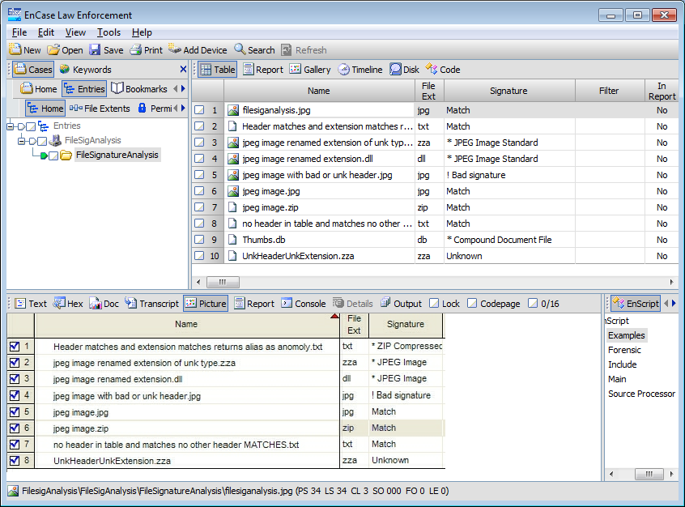

Slide 50
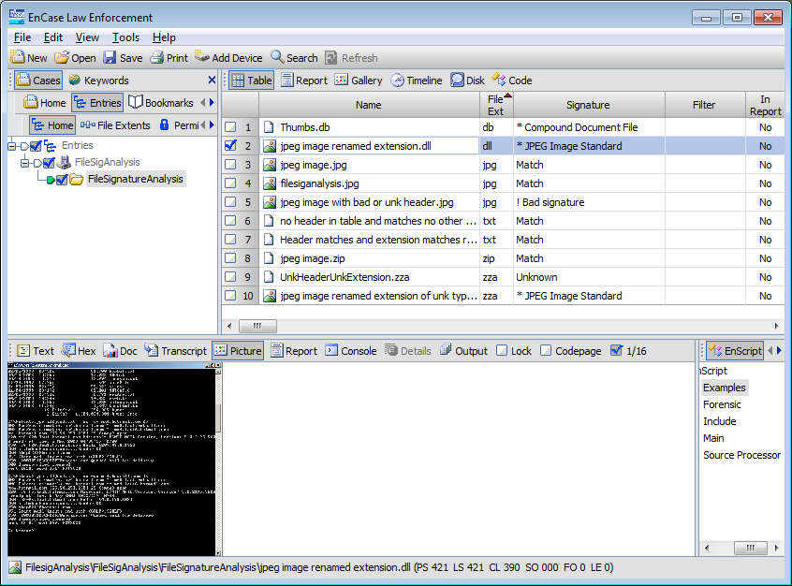

Slide 51
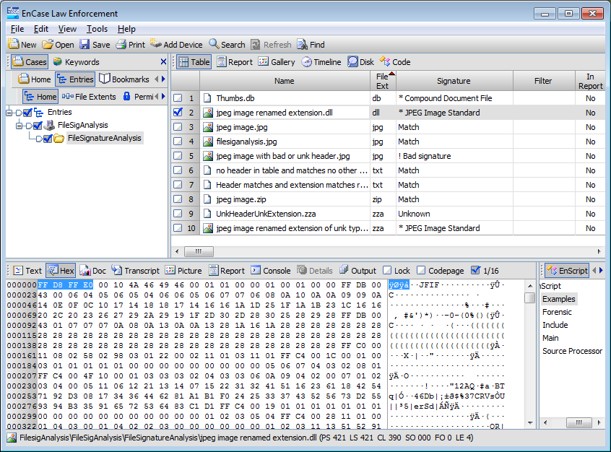

Slide 52
Four principles of the ACPO Guidelines
Principle 1: No action taken by law enforcement agencies or their agents should change data held on a computer or storage media which may subsequently be relied upon in court.
Principle 2: In exceptional circumstances, where a person finds it necessary to access original data held on a computer or on storage media, that person must be competent to do so and be able to give evidence explaining the relevance and the implications of their actions.

Slide 53
Principle 3: An audit trail or other record of all processes applied to computer based electronic evidence should be created and preserved. An independent third party should be able to examine those processes and achieve the same result.
Principle 4: The person in charge of the investigation (the case officer) has overall responsibility for ensuring that the law and these principles are adhered to.

Slide 54
Conclusion
Looked at data – different types
Conducting a basic search
Introduction to Grep
Bookmarking your findings
Creating reports
File signature analysis
ACPO guidelines

